Slide 1






Securing ASP.NET Web Application
Presented By :
Muhammad Atif Hussain
Deputy Manager IT (Takaful Pakistan Limited)
Technologies Consultant (AUC Technologies)
MCS(KU)
MSCS(SZABIST)
MCP
MCAD
MCSD
MCTS (Windows, Web, Distributed Applications)
MCPD (Enterprise Applications)
MCT(Microsoft Certified Trainer)

Slide 2
Agenda
Web Application Security Overview
Windows-Based Authentication
Forms-Based Authentication

Slide 3
Web Application Security Overview
Authentication vs. Authorization
What Are the ASP.NET Authentication Methods?
Comparing the ASP.NET Authentication Methods
What Are the IIS Authentication Mechanisms?
Demonstration: IIS Authentication Mechanisms
What Is Secure Sockets Layer?
Notes:
Module 16: Securing a Microsoft ASP.NET Web Application
Course 2310C

Slide 4
Authentication v/s Authorization
Authentication:
  Accepts credentials from a user
  Validates the credentials
Authorization:
  Given the authentication credentials supplied, determines the right to access a resource
  Assign authorization by user name or by role
Notes:
Module 16: Securing a Microsoft ASP.NET Web Application
Course 2310C
Check that the students can confidently provide a definition of authentication and authorization. Point out that authentication relates to the logon process and authorization relates to permissions.

Slide 5
ASP.NET Authentication Methods
Windows-based authentication
  Relies on the Windows operating system and IIS
  User requests a secure Web page and the request goes through IIS
  After credentials are verified by IIS, the secure Web page is returned
Forms-based authentication
  Unauthenticated requests are redirected to an HTML form
  User provides credentials and submits the HTML form
  After credentials are verified, an authentication cookie is issued
Notes:
Module 16: Securing a Microsoft ASP.NET Web Application
Course 2310C
Distinguish between the two methods of authentication and explain the key features of each.

Slide 6
Comparing ASP.NET Authentication Methods
Method | Advantages | Disadvantages
Windows-based Authentication | Uses existing Windows infrastructure Controls access to sensitive information | Not appropriate for most Internet applications
Forms-based Authentication | Good for Internet applications Supports all client types | Based on cookies
Notes:
Module 16: Securing a Microsoft ASP.NET Web Application
Course 2310C
Explain to the students when they can use each authentication method in a Web application.

Slide 7
IIS Authentication Methods
Mechanisms | Security Level | Mechanisms
Anonymous | None | No authentication occurs
Basic | Low (Medium with SSL) | Client sends username and password as clear text Can be encrypted by using SSL Part of the HTTP specification and supported by most browsers
Digest | Medium | Sends information as encoded hash Requires Internet Explorer 5, 6, or 7 Requires Active Directory
Integrated Windows | High | Uses either NTLM or Kerberos Generally good for intranets, not Internet Does not work through most firewalls
Notes:
Module 16: Securing a Microsoft ASP.NET Web Application
Course 2310C
Explain to the students that they must configure IIS before they can use Microsoft® Windows® authentication. Briefly explain each IIS authentication mechanism. Mention that NTLM represents ‘NT LAN Manager‘.

Slide 8
Demonstrate: IIS Authentication Mechanism
Open the Computer Management console
Display the authentication methods for the deployed Web site
Notes:
Module 16: Securing a Microsoft ASP.NET Web Application
Course 2310C
In this demonstration, students will see the IIS authentication mechanisms. Mention that IIS is slightly different for each version of Windows.
Open the Computer Management console
Click Start, right-click Computer, and then click Manage.
In the User Account Control dialog box, click Continue.
Display the authentication methods for the deployed Web site
In the Computer Management console, in the left pane, expand Services and Applications, and then click Internet Information Services (IIS) Manager.
In the Connections pane, expand LONDON (LONDON\Student), expand Web Sites, and then click Default Web Site.
In the Default Web Site Home pane, double-click Authentication.
In the Authentication pane, point out the IIS authentication mechanisms.
Enable and disable an authentication mechanism.
Close the Computer Management console.

Slide 9
Secure Socket Layer
SSL is a protocol that transmits data securely across a network. SSL secures data by using:
  Data encryption:
    Ensures that the data sent is read only by a secure target server
  Server authentication:
    Ensures that data is sent to the correct server
    Uses the server and client certificates
  Data integrity:
    Protects the integrity of the data
    Includes a message authentication code that detects whether a message is altered
SSL uses Hypertext Transfer Protocol Secure to retrieve an ASP.NET Web page
Notes:
Module 16: Securing a Microsoft ASP.NET Web Application
Course 2310C
Do not spend too much time on this topic. The CD content for this slide provide a good overview of Secure Sockets Layer (SSL), and the students can read these notes at their own pace. Explain the term phishing: a type of e-mail scam that steals your identity.

Slide 10
Lesson: Windows-Based Authentication
Enabling Windows-Based Authentication
Reading User Information
Notes:
Module 16: Securing a Microsoft ASP.NET Web Application
Course 2310C

Slide 11
Enabling: Windows-Based Authentication
Configure IIS to use one or more of the following
authentication mechanisms:
  Basic, Digest, Integrated Windows security
1
2
Set Windows-based authentication in Web.config
<system.web>
<authentication mode="Windows" />
</system.web>
3
Set up authorization in Web.config
When users access the Web Form, IIS requests
logon information
4
Notes:
Module 16: Securing a Microsoft ASP.NET Web Application
Course 2310C
This topic explains the four-step process that you use to secure Web applications by using Windows-based authentication:
1. Configure IIS.
2. Set up authentication in the web.config file.
3. Set up authorization in the web.config file.
4. IIS requests logon information from the users.
Emphasize that impersonation is optional in ASP.NET and is disabled by default. To enable impersonation, you must configure the web.config file.

Slide 12
Reading User Information
After authentication, the Web server can read the user identity
[Visual C#]
userLabel.Text = User.Identity.Name;
userTypeLabel.Text = User.Identity.AuthenticationType;
userAuthenticatedLabel.Text = User.Identity.IsAuthenticated;
[Visual Basic]
userLabel.Text = User.Identity.Name
userTypeLabel.Text = User.Identity.AuthenticationType
userAuthenticatedLabel.Text = User.Identity.IsAuthenticated
Notes:
Module 16: Securing a Microsoft ASP.NET Web Application
Course 2310C
Briefly explain the code required to read user information. Mention that User.Identity is not limited to Windows-based authentication.

Slide 13
Lesson: Forms-Based Authentication
Overview of Forms-Based Authentication
Multimedia: Forms-Based Authentication
Enabling Forms-Based Authentication
Creating a Logon Page
Demonstration: Forms-Based Authentication
Notes:
Module 16: Securing a Microsoft ASP.NET Web Application
Course 2310C

Slide 14









1
2
IIS
ASP.NET Forms authentication
Client requests page
Not
authenticated
Authenticated
Authorized
6
Username
4
Access denied
Someone
Password
Logon page
(users enter
their credentials)
*******
Submit
Not
Authenticated
3
Authenticated
Authorized
Requested secure page
Authentication cookie
7
5
Notes:
Module 16: Securing a Microsoft ASP.NET Web Application
Course 2310C
Ensure that the students understand the sequence of events for Forms-based authentication.

Slide 15
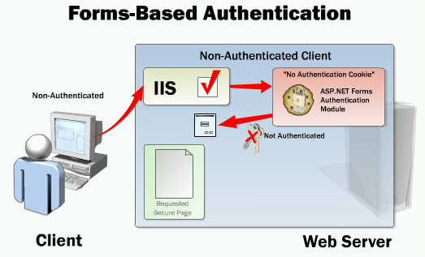

Multimedia: Forms-Based Authentication
Notes:
Module 16: Securing a Microsoft ASP.NET Web Application
Course 2310C
Explain that the multimedia shows how Forms-based authentication works with a
non-authenticated client and with an authenticated client.

Slide 16
Enabling: Forms-Based Authentication
1
Configure IIS to use Anonymous authentication
2
Set Forms-based authentication in Web.config
<authentication mode="Forms" >
<forms name=".namesuffix"
loginUrl="login.aspx" />
</authentication>
3
Set up authorization
4
Build a logon Web Form
Notes:
Module 16: Securing a Microsoft ASP.NET Web Application
Course 2310C
Explain the steps required to enable Forms-based authentication.

Slide 17
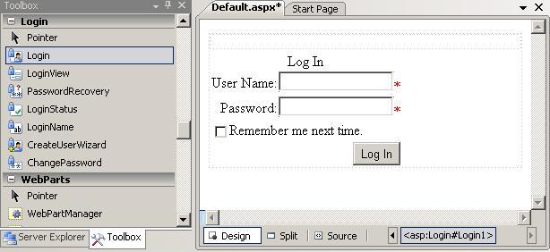
Creating a Logon Page
ASP.NET login controls
Creating a logon page
Reading credentials from cookies
Notes:
Module 16: Securing a Microsoft ASP.NET Web Application
Course 2310C
Explain that a logon page is a standard .aspx Web Form that contains logon controls.
If time permits, display the login controls in the Toolbox of Microsoft Visual Studio®. Add different login controls to a Web page and emphasize their specific login properties.

Slide 18
Form-Based Authentication
Examine authentication and authorization in web.config
Examine the logon and register pages
Run the demonstration
Notes:
Module 16: Securing a Microsoft ASP.NET Web Application
Course 2310C
In this demonstration, students will see how implement Forms-based authentication.
Examine authentication and authorization in web.config
In Visual Studio, open the Web site in the E:\Democode\CS\FormsAuthentication or E:\Democode\CS\FormsAuthentication folder.
In Solution Explorer, double-click the web.config file.
Examine the <authentication> element that enables Forms authentication and redirects unauthenticated users to the LoginDemo.aspx page.
Examine the <location> elements that set the SecurityPageDemo1.aspx and SecurityPageDemo2.aspx pages to require authorization.
Examine the logon and register pages
Open the LogonDemo.aspx page in Design view to display the Logon control.
Open the RegisterDemo.aspx page in design view to display the CreateUserWizard control.
Run the demonstration
In Solution Explorer, right-click NonSecurePageDemo.aspx, and then click View in Browser.
You can access the non-secure page.
In the browser, click the SecurePageDemo1 link.
You are redirected to the LogonDemo.aspx page because you are not an authenticated user and the SecurePageDemo1.aspx page is a secure page. Show that you are automatically redirected to the LoginDemo.aspx page. Show that the URL contains the SecurePageDemo1.aspx page.
Enter the user name Bob and the password Pa$$w0rd, and then click Log In.
You cannot access the secure page because you are not a registered user.
In the browser, click the link to register a new user.
Register the user name Bob and the password Pa$$w0rd, and then click Create
User.

Slide 19


Slide 20
Questions
?

